Slide 1
Virtualization

Slide 2
What is a Virtualization?
Virtualization is a technology that enables the creation of virtual environments from a single physical machine, allowing for more efficient use of resources by distributing them across computing environments.
https://www.ibm.com/think/topics/virtualization

Slide 3
What is a Virtual Machine?
A virtual machine (VM) is a virtual environment that simulates a physical computer in software form. VMs are usually referred to as guests, with one or more “guest” machines running on a host machine.
https://www.ibm.com/think/topics/virtualization

Slide 4
What is a Hypervisors?
A hypervisor is the software layer that coordinates VMs. It serves as an interface between the VM and the underlying physical hardware, ensuring that each has access to the physical resources it needs to execute. It also makes sure that the VMs don’t interfere with each other by impinging on each other’s memory space or compute cycles.
https://www.ibm.com/think/topics/virtualization

Slide 5
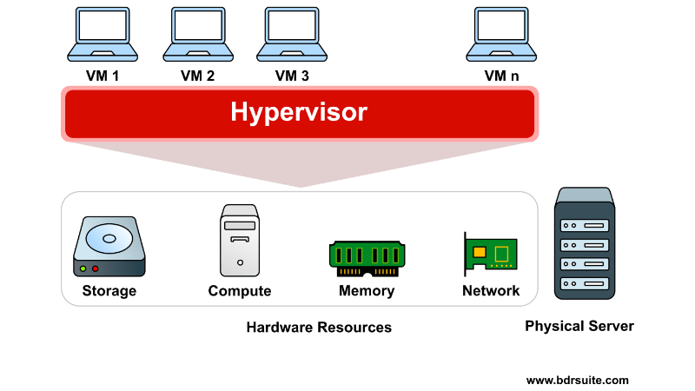
https://www.ibm.com/think/topics/virtualization

Slide 6
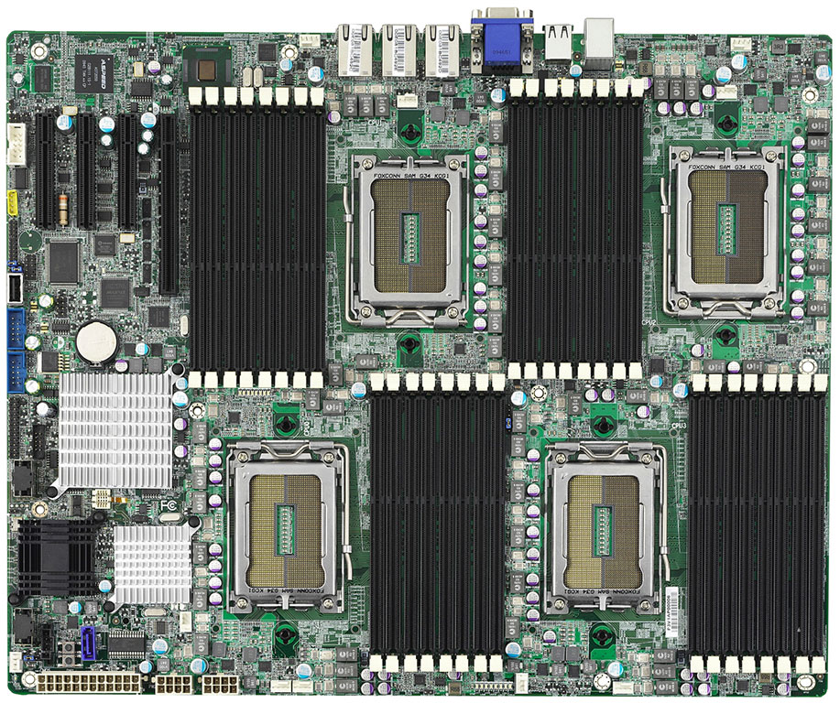
https://www.ibm.com/think/topics/virtualization

Slide 7
There are two types of hypervisors:
Type 1 or “bare-metal” hypervisors interact with the underlying physical resources, replacing the traditional operating system altogether. They most commonly appear in virtual server scenarios in which a software-based server is created by partitioning a physical server into smaller, self-contained segments, each capable of running its own operating system and applications.
Type 2 hypervisors run as an application on an existing OS. Most commonly used on endpoint devices to run guest operating systems, they carry a performance overhead because they must use the host OS to access and coordinate the underlying hardware resources.
https://www.ibm.com/think/topics/virtualization

Slide 8
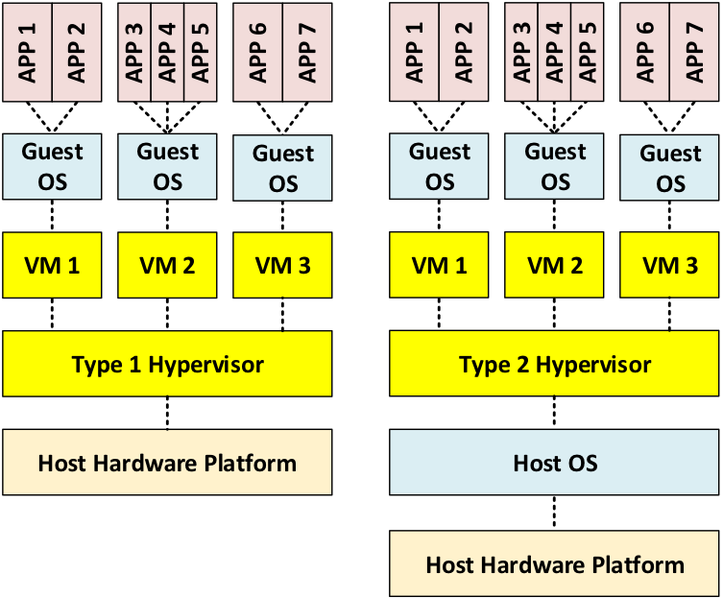
https://www.ibm.com/think/topics/virtualization

Slide 9
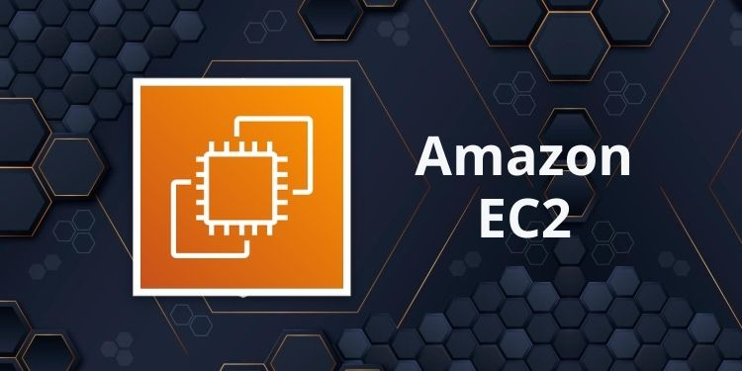

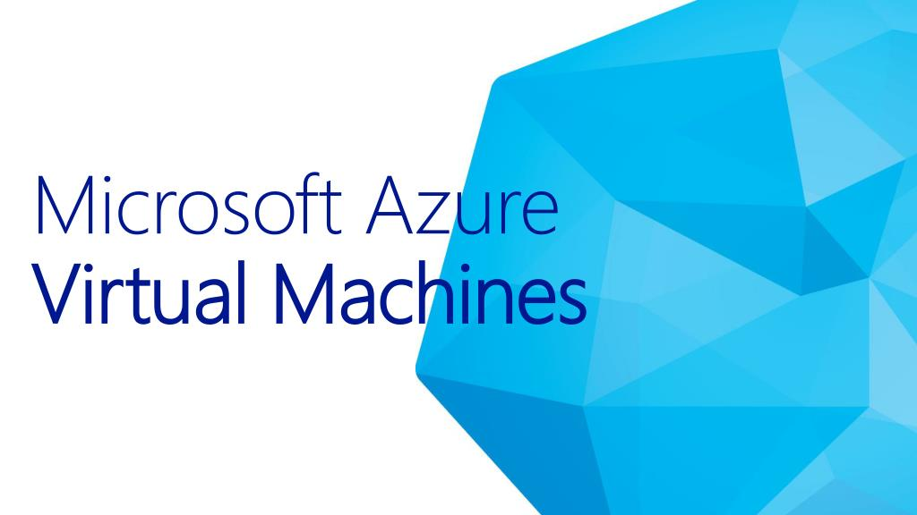

Slide 10
Connecting to a VM

Slide 11
“
“If you only do what you can do, you will never be more than you are now.”
– Master Shifu

